Slide 1
TEMPERATURE MONITORING AND DATA LOGGING
by Fatih YARDIM
27th January 2025

Slide 2
THE FEATURES OF THE SYSTEM
The system
reads the temperature data once a second
records temperature data with its timestamp
enables the user to set high and low threshold temperatures
receives the log request from the user
compares readings to the user defined high and low thresholds
sends the logged temperature values with its timestamp to the user
informs the user about the faulty conditions

Slide 3
SYSTEM HARDWARE DESIGN
The system consists of 6 units given below:
Temperature Measurement Unit
Data Logging Unit
Real-Time Clock Unit
Alarm Triggering Unit
Communication Unit
User Interface Unit

Slide 4
SYSTEM SOFTWARE DESIGN
The system software consists of 10 units given below:
Main Unit
Common Unit
Data Logging Unit
Alarm Triggering Unit
Temperature Measurement Unit
User Interface Unit
Real-Time Clock Unit
Communication Unit
Hardware Abstraction Layer Unit
Operating System Unit

Slide 5
SYSTEM HARDWARE IMPLEMENTATION
The components making up the system:
STM32F407 MCU
DHT-11 digital temperature sensor to read temperature
24C256 256 Kbits EEPROM to record data
Internal Real-Time Clock Peripheral
Green and red warning LEDs to alert the user
Internal UART used by MCU
PC and CP2102 USB to UART module

Slide 6
SYSTEM SOFTWARE IMPLEMENTATION (1)
The main unit runs 4 tasks, created by FreeRTOS, given below:
User Interface: checks whether an incoming message exists
Temperature Measurement: periodically measures temperature gets timestamp and sends the current data to the user
Alarm Triggering: compares the current temperature to the user defined thresholds and lights or turns off LEDs to warn the user
Data Logging: records the temperature with its timestamp to the EEPROM
The other features of the system software:
checks error conditions such as sensor disconnection, corrupted data, invalid date, and invalid command
sends the overall logged data in case of a user request
updates the high and low thresholds in EEPROM
runs user interface and alarm triggering tasks every 100 msecs
runs temperature measurement and data logging tasks every 1 sec
suspends the temperature measurement while the user log request is being serviced

Slide 7
SYSTEM SOFTWARE IMPLEMENTATION (2)
The system software:
was developed in IAR Embedded Workbench IDE
was written in C programming language
communicated with user interface through the Docklight serial communication terminal
utilized HAL and FreeRTOS lower layer software constructed by STM32CubeMX program
was uploaded to the MCU by a ST-LINK V2 programmer

Slide 8
TEST CASES (1)
The system is tested and validated concerning the following cases:
Normal operation: The temperature is read every 1 sec, the current timestamp is obtained, and the temperature with its timestamp is sent to the user prompt
User intervention: The system is tested via the commands, given below, sent by the user prompt
The Log Request: the overall recorded data in the EEPROM is sent to the user
High Threshold: the value sent with the command is recorded to the EEPROM, it is compared to the current temperature, and the red LED status is updated, accordingly
Low Threshold: the value sent with the command is recorded to the EEPROM, it is compared to the current temperature, and the green LED status is updated, accordingly

Slide 9
TEST CASES (2)
Abnormal operation: The system is tested under the following inconveniences and an error message is sent to the user prompt
Temperature Measurement
Sensor Disconnection: The data pin of the sensor is broken and no other steps are applied since the reading is unsuccessful, except an error message is sent to the user
Out of range data: The debugger is paused and the measured temperature is altered to a value higher than 50.
User intervention: The system is tested via the commands, given below, sent by the user prompt
An unlike command provided that the first char is kept the same as that of the valid commands and the succeeding chars are different from the normal command’s data
An unlike command whose first char and all other content is different from the original one
An unlike and longer command to cause a message buffer overflow

Slide 10
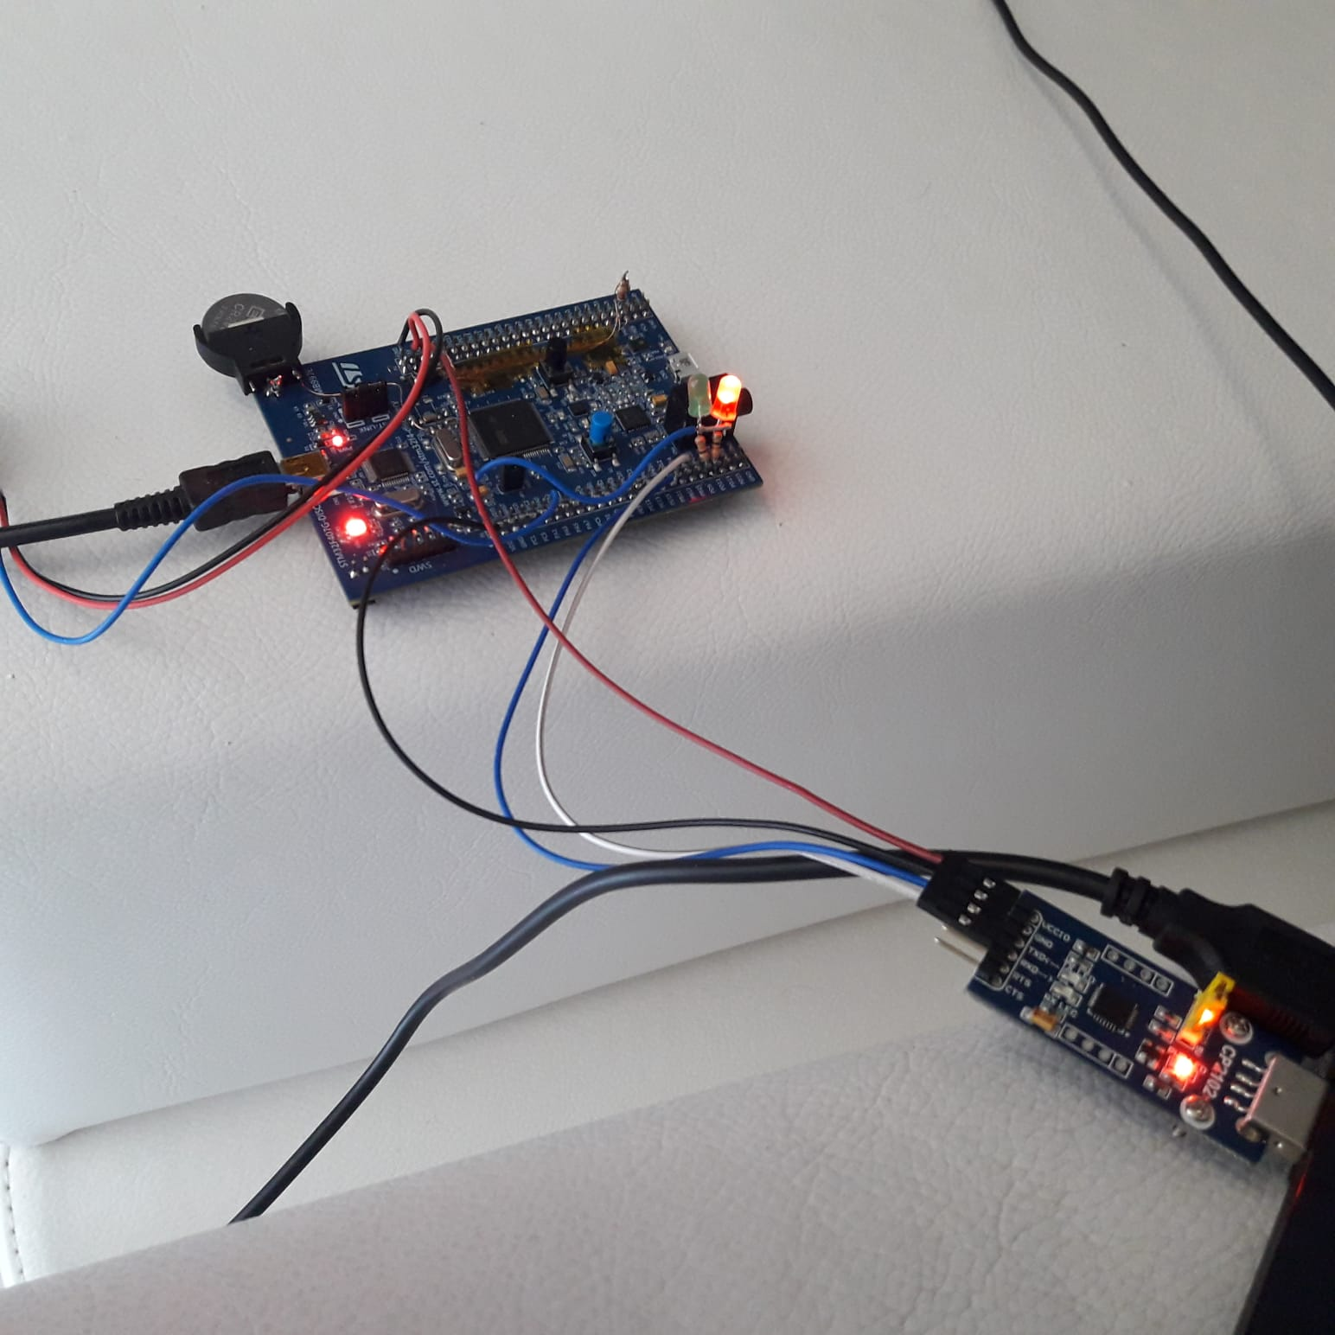
TEST SETUP

Slide 11
RESULTS AND CONCLUSION
All test cases were covered and the system was validated from the developer’s view
It is ready for the next stage which aims to observe how the proved system works at the client side.

